Slide 1
Final Project
Team 4
b05902108 施承志
b05902036 夏瑜
b04502051 陳邦元
Notes:
Good afternoon everyone, this is our final project presentation, we’re team 4.
And they’re are my teammates listed here and they’re in minda waiting for the demo.

Slide 2
Outline
Introduction and video (5 min)
demo (10 min)
Q & A (2 min)
Notes:
And this is our outline, first take few minutes to introduce what we are going to present and show a video. And then we’ll take lots of time demo. And finally Q & A.

Slide 3
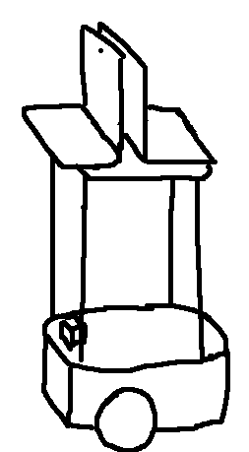

CSIE Retriever
notebook with camera and audio input/output
(under same network to communicate)
ROS system including localization and planning
Guide people through CS-building
System architecture
face recognition through camera
OCR
Tesseract OCR
speech recognition through microphone
localization: gmapping
planning: Local/Global planner
DeepSpeech
deep-learning bsed
speech recognization
LSTM based OCR engine
Realsense
Pioneer
Python
face recognition
Notes:
So, we’re the team doing guiding, guide some people through CS-building and take some people to the target.
And here is our system architecture:
We’re using pioneer and a sensor. And two notebooks next to each other. both with the camera and audio input/output and they are under same network to communicate and send messages and information.
ROS system is one the right notebook to do localization, planning and state control. and these are the packages doing localization and planning.
face recognition is also on the right notebook whose camera is facing toward user to recognize user’s face and calculate its area, so we can detect whether user is still following behind the pioneer. We use python face recognization to do it. It can detect the user face and extract features and have a model to find the relation between features and users.
And OCR is on the left notebook. It use the camera to detect words in front of it. And we use tesseract OCR which is LSTM based OCR engine
speech recognition is also on the left to balance the load between two computers and it can recognize what user says. The package we use is DeepSpeech.

Slide 4
Video
(1 min 20 sec)
https://youtu.be/5dW5o2pRmV4
Notes:
OK, we have a video here

Slide 5
Demo
Localization and recognizing different places
A user ask for a known place
Interaction with the user (remind him or her to be closer)
Resume the guide to the target for a lost user
Notes:
What we are going to demo is just like we did in the video, we’ll first construct the map, and take user to the target, we’ll sometimes fall behind the pioneer to let it tell us to catch up. And we’ll also pretend that we are going to other place and we’ll get back later to check whether pioneer will resume the guide and take us to the target place.

Slide 6
Future work
More interaction with users
Come up with more functionalities
Robustness and stability
Notes:
We can have more interaction with users like it can smartly ask person who is in need or chat with the person while guiding.
Come up with more functionalities like open the door or press the elevator button
We still need to enhance robustness and stability

Slide 7
Division of works
Everyone did everything

Slide 8
Thanks for listening

